Slide 1
CSE101-Lec#23
DERIVED TYPES

Slide 2
Outline
Declaration of a structure
Definition and initialization of structures.
Accessing structures.

Slide 3
Introduction
Structure is a user-defined datatype, which allows us to combine data of different types together.
Structure helps to construct a complex data type which is more meaningful. It is somewhat similar to an Array, but an array holds data of similar type only. But structure on the other hand, can store data of any type, which is practically more useful.
Structures are used to represent a record. Suppose you want to keep track of your books in a library. You might want to track the following attributes about each book −
Title
Author
Subject
Book ID

Slide 4


Why Use Structures?
Quite often we deal with entities that are collection of dissimilar data types.
For example, suppose you want to store data about a car. You might want to store its name (a string), its price (a float) and number of seats in it (an int).
If data about 3 such cars is to be stored, then we can follow two approaches:
  Construct individual arrays, one for storing names, another for storing prices and still another for storing number of seats.
  Use a structure variable.

Slide 5
Structure
There are three aspects of working with structures:
  Defining a structure type.
  Declaring variables and constants of newly created type.
  Using and performing operations on the objects of structure type.

Slide 6
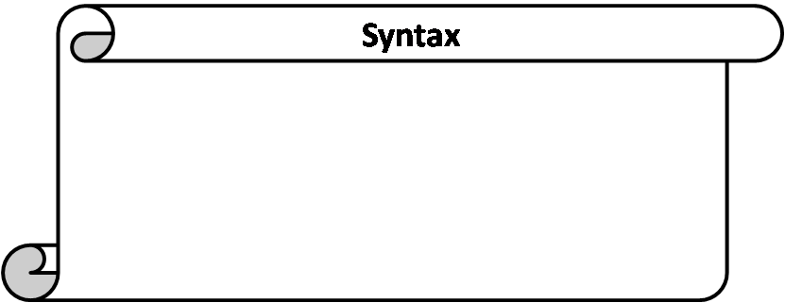
Structure Definition
struct sname {
data_type var1;
data_type var2;
data_type var3;
.
.
type varN;
};
struct is a keyword to define a structure.
sname is the name given to the structure, also called structure tag.
type is a built-in data type.
var1,var2,var3,…..,varN are elements of structure being defined.
; semicolon at the end.

Slide 7
Example
.
.
We can create the structure for a person as mentioned as:
struct person
{
char name[50];
int citNo;
float salary;
};
**Don't forget the semicolon }; in the ending line
This declaration above creates the derived data type struct person

Slide 8
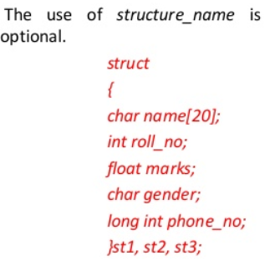
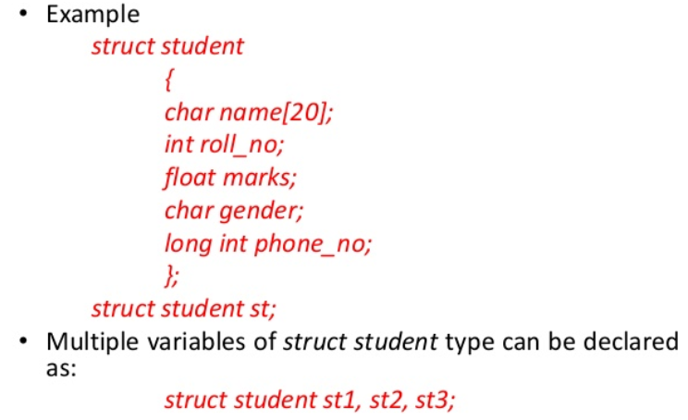

Slide 9
Structure Declaration
struct information
  A structure definition does not reserve space in memory .
  Instead creates a new data type to define structure variables.
Defining variables of structure type
  Defined like other variables:
      Car, myCar, cars[5], *cPtr;
  Can use a comma separated list along with structure definition:
      struct car
      {
      char *name;
      int seats;
      float price;
      } myCar, cars[5], *cPtr;
**At this point, the memory is set aside for the structure variable myCar.

Slide 10
How the members are stored in memory
Consider the declarations to understand how the members of the structure variables are stored in memory
struct car
{
char *name;
int seats;
float price;
} myCar;
Note: all members are stored in contiguous memory location in order in which they are declared.

Slide 11
How the members of the structure variables are stored in memory?
1197
1198
1199
1200
1201
1202
1203
1204
1205
1206
1207
1208
1209
1210
1211
name
seats
price

Slide 12
Structure Declaration
It is possible to declare variables of a structure, either along with structure definition or after the structure is defined.
Structure variable declaration is similar to the declaration of any normal variable of any other datatype. Structure variables can be declared in following two ways:
1) Declaring Structure variables separately
2) Declaring Structure variables with structure definition

Slide 13
.
1) Declaring Structure variables separately
struct Student
{
char name[25];
int age;
char branch[10];
//F for female and M for male
char gender;
}; struct Student S1, S2; //declaring variables of struct Student
2) Declaring Structure variables with structure definition
struct Student
{
char name[25];
int age;
char branch[10];
//F for female and M for male
char gender;
}S1, S2; //declaring variables of struct Student
Here S1 and S2 are variables of structure Student. However this approach is not much recommended

Slide 14
Operations on Structures
Operations that can be performed on structures:
  Assigning a structure to a structure of the same type
  Taking the address (&) of a structure
  Accessing the members of a structure
  Using the sizeof operator to determine the size of a structure

Slide 15
Initializing Structures
Initializer list: To initialize a structure similarly like arrays
Example:
    car myCar = { “Renault", 500000, 2 };
    Could also define and initialize myCar as follows:
    Car myCar;
    myCar.name = “Renault”;
    myCar.price = 500000;
    myCar.seats = 2;

Slide 16
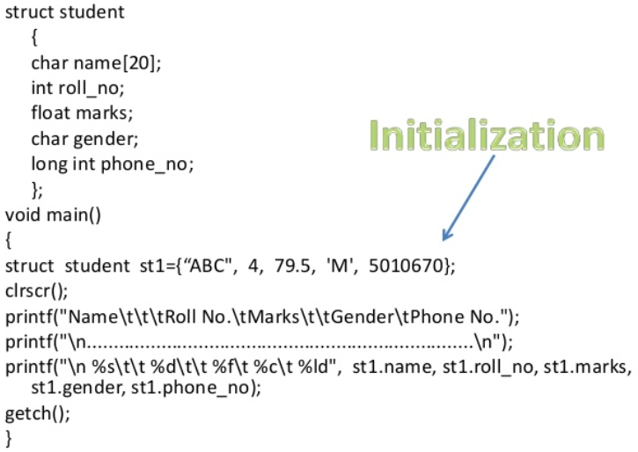

Slide 17
Accessing Members of Structures
Two operators are used to access members of Structures:
  Dot operator (.): used with structure variables
    car myCar;
    Printf("%d", myCar.seats);
  Arrow operator (->): used with pointers to structure variables
    car *myCarPtr = &myCar;
    printf("%d", myCarPtr->seats);
  myCarPtr->name is equivalent to (*myCarPtr).seats

Slide 18
Dot(.) Operator
Members are accessed using dot operator.
It provides a powerful and clear way to refer to an individual element.
Syntax: sname.vname
sname is structure variable name.
vname is name of the element of the structure.
Eg: the members of the structure variable myCar can be accessed as
myCar.name, myCar.seats, myCar.price

Slide 19
Use of Assignment Statement for Structures
The main advantage of structure is that it can be treated as single entity.
The only legal operations that can be performed on structure are copying to it as a single unit using the assignment operator.
Value of one structure variable can be assigned to another variable of the same type using simple assignment statement.
If myCar and newCar are structure variable of type car, then
newCar = myCar;

Slide 20
Use of Assignment Statement for Structures
When we assigns value of structure variable myCar to newCar, all values of members of one structure get copied into corresponding members of another structure.
Or we can copy one member at a time:
  newCar.name = myCar.name;
Simple assignment cannot be used this way for arrays.
This is really a big advantage over arrays where in order to copy one array into another of same type, we have copied the contents element by element either using loop or individually.

Slide 21
Program to show how to access structure.
#include <stdio.h>
struct car{
char *name;
int seats;
float price;
}; //end structure car
int main()
{
struct car myCar; //define struct variable
myCar.name = “Renault";
myCar.price = 500000;
myCar.seats = 2;
printf("%s %f %d \n”, myCar.name, myCar.price, myCar.seats);
} //end main
Renault 500000 2

Slide 22
Program to enter data into structure.
#include <stdio.h>
struct car{
char name[50];
int seats;
float price;
};
main()
{
struct car myCar;
printf(“Enter name of car:\n”);
gets(myCar.name);
printf(“Enter number of seats in car:\n”);
scanf(“%d”, &myCar.seats);
printf(“Enter price of car:\n”);
scanf(“%f”, &myCar.price);
printf(“\n\nParticulars of car are:\n”);
printf(“Car name:%s”,myCar.name);
printf(“\nNumber of seats:%d”, myCar.seats);
printf(“\nPrice:%f”, myCar.price);
} //end main

Slide 23
Enter name of car: Micra
Enter number of seats in car: 4
Enter price of car: 600000
Particulars of car are:
Car name: Micra
Number of seats: 4
Price: 600000

Slide 24
Array & Structure
Array | Structure
1. It is a collection of data items of same data type. | 1. It is a collection of data items of different data types.
2. It has declaration only. | 2. It has declaration & definition.
3. There is no keyword. | 3. struct is the keyword.
4. An array name represents the address of the starting element. | 4. A structure name is called tag. It is a short hand notation of the declaration.
5. An array cannot have bit fields. | 5. It may contain bit fields.

Slide 25
typedef
typedef
  Creates synonyms (aliases) for previously defined data types
  Use typedef to create shorter type names
  Example:
      typedef struct car CAR;
  Defines a new type name CAR as a synonym for type struct car *
  typedef does not create a new data type
    Only creates an alias

Slide 26
typedef
C programmers often use typedef to define a structure type, so a structure tag is not required.
For example, the following definition
    typedef struct {
    char *name;
    int seats;
    flaot price
    }car;
creates the structure type car without the need for a separate typedef statement.
car myCar; /*we can create variable of car without using struct keyword*/

Slide 27
Next Class: Structure, functions and pointers

